Slide 1
Bidrectional CLLC Converter Control and Monitor
Speaker: Chi-Duong, Ngo(吳志陽)

Slide 2
Content
1. Introduction
2. Method
3. Window-Form Application
4. Result
5. Conclusion

Slide 3
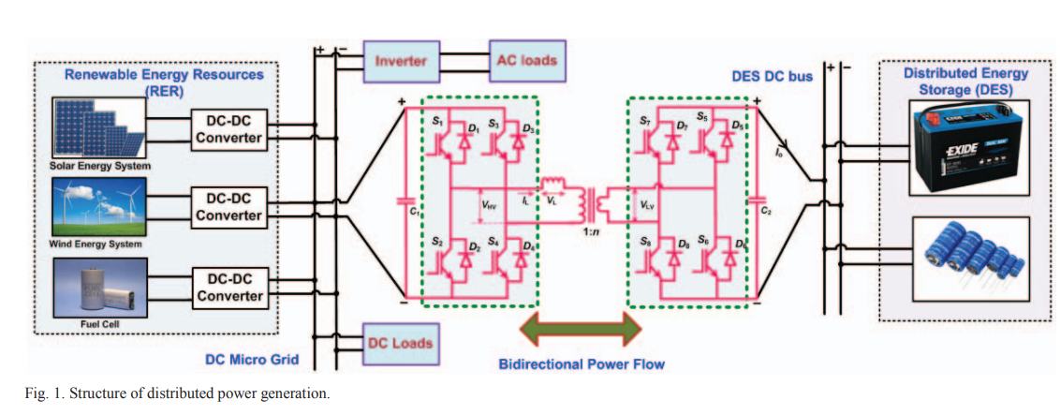
1. Introduction
Bidirectional converter is popular is LLC converter and CLLC converter.
Example:
The DC voltage of DC Micro Grid: 400VDC
The required DC Voltage of DES: 12VDC
=> We can using the Buck Converter. But the requirement is can charge and dischagre the DES, so using the birectional converter is the good solution
Notes:
https://ieeexplore.ieee.org/stamp/stamp.jsp?tp=&arnumber=8883267

Slide 4
2. Method
The requirement for CLLC Converter:
Can still maintain stable output voltage when changing load
Can control forward and backward the power flow
To control the CLLC Converter we need to control 8 MOSFETS switching on the same time.
These many methods to control the CLLC Converter, but when comparing the advantage and disadvantage: Combining the VCO(Voltage Control Oscillator) and DPS(Dual-Phase Shift) method is proposed.
These above method will be apply on the STM32G474 Board with STM32 Microcontroller
Notes:
https://ieeexplore.ieee.org/stamp/stamp.jsp?tp=&arnumber=8883267

Slide 5
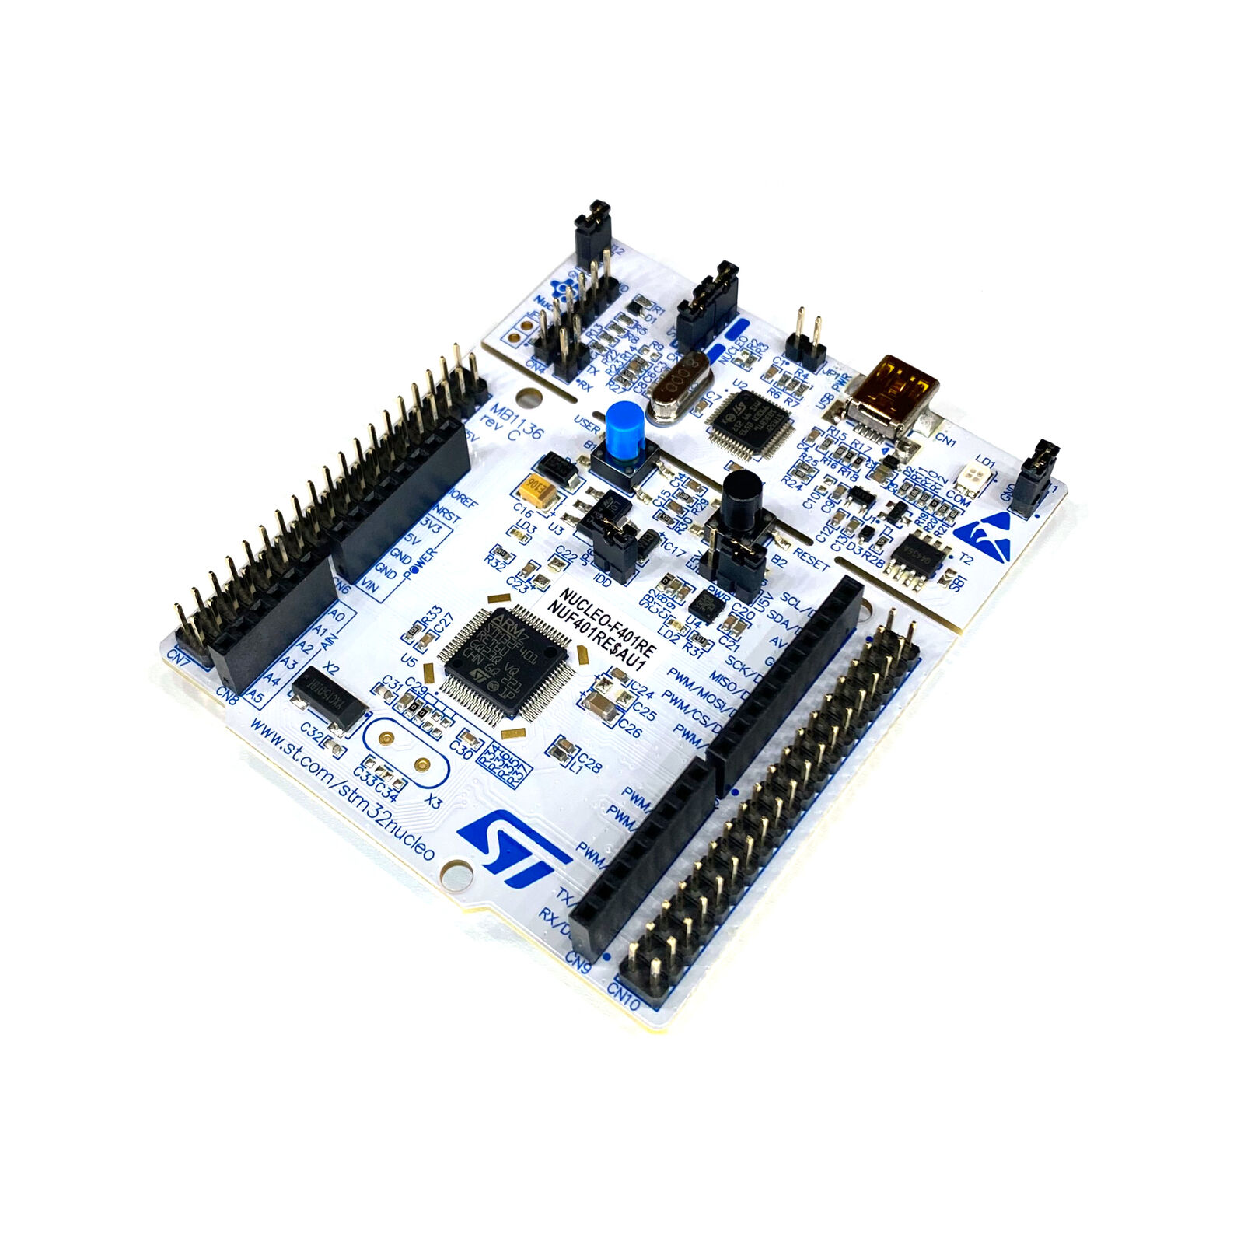
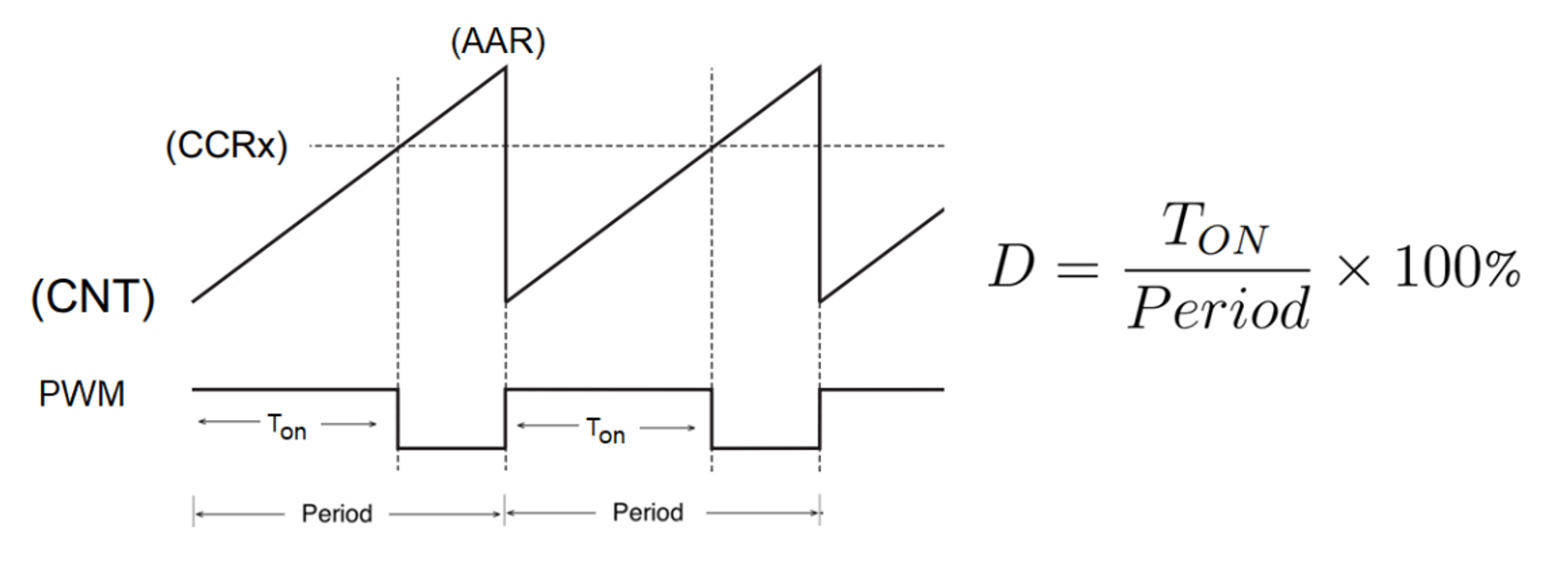
2. Method
Voltage Controlled Oscillator:
- The frequency is controllerd by the voltage
- Using the module timer of STM32F4 to control the frequency
Notes:
https://ieeexplore.ieee.org/stamp/stamp.jsp?tp=&arnumber=8883267

Slide 6
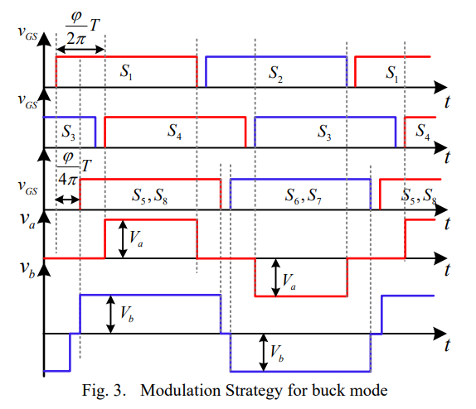
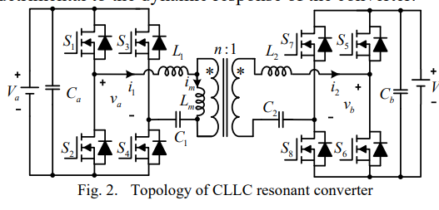
2. Method
DPS Method
Notes:
https://ieeexplore.ieee.org/stamp/stamp.jsp?tp=&arnumber=8883267

Slide 7
2. Method
Close-Loop Control
s1
s4
s5
s8
i_{ouput}
PI controller
PI controller
PWM Amplifer
DPS Method
VCO
GATE Driver
i_{ref}
V_{ref}
V_{ouput}
Notes:
https://ieeexplore.ieee.org/stamp/stamp.jsp?tp=&arnumber=8883267

Slide 8
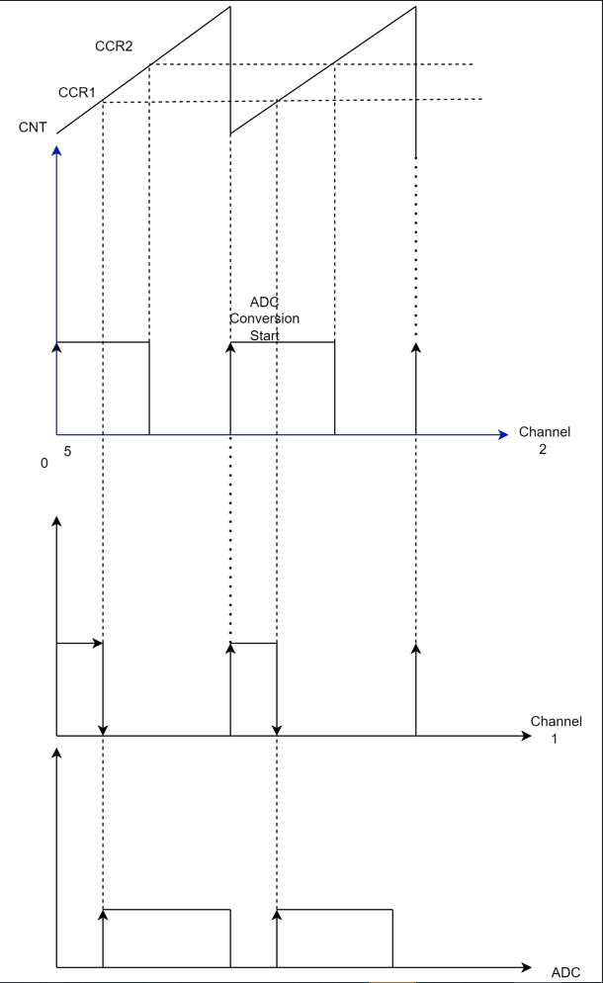
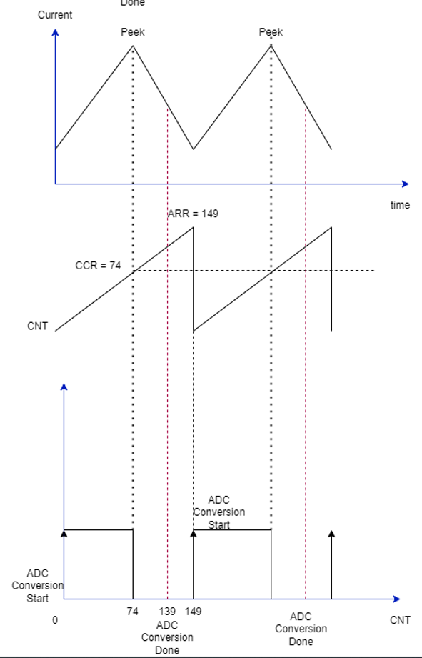
2. Method
Relationship betwen ADC and TIMER
Should
Avoid
PWM
TIMER
ADC
ADC
Notes:
https://ieeexplore.ieee.org/stamp/stamp.jsp?tp=&arnumber=8883267

Slide 9
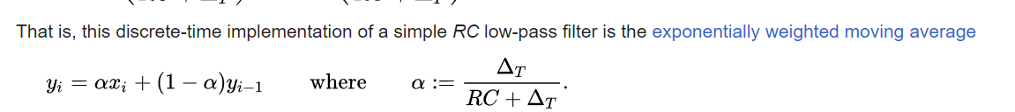
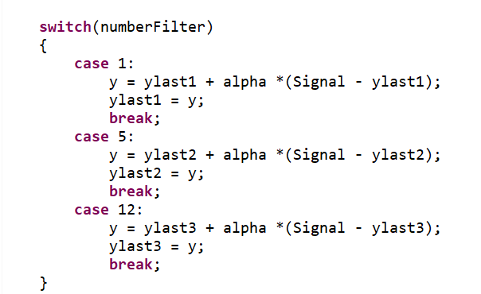
2. Method
To exactly measure voltage and current using ADC module
While measuring with the ADC module, which always has the noises, so I uses the low pass filter to remain the desired value
Follow the fomula:
Notes:
https://ieeexplore.ieee.org/stamp/stamp.jsp?tp=&arnumber=8883267

Slide 10
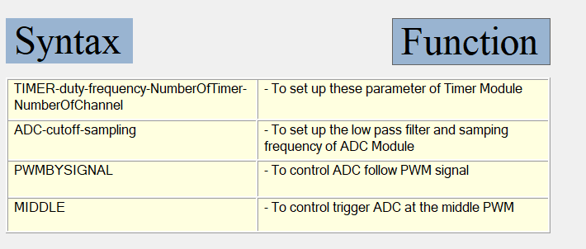
3. Window-Form Application
Design the Windown-Form to help test these functions:
Can manually configure the parameter of TIMER to test PWM, DPS method
Can manually configure the filter parameter of ADC
Can show the value output voltage and output current on the chart
Notes:
https://ieeexplore.ieee.org/stamp/stamp.jsp?tp=&arnumber=8883267

Slide 11
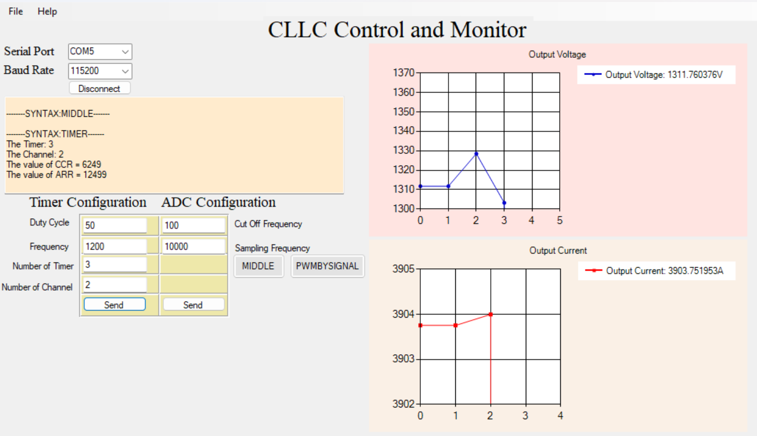
3. Window-Form Application
UART port
Monitoring the response data
Voltage chart
Timer configuration
ADC configuration
Current chart
Notes:
https://ieeexplore.ieee.org/stamp/stamp.jsp?tp=&arnumber=8883267

Slide 12
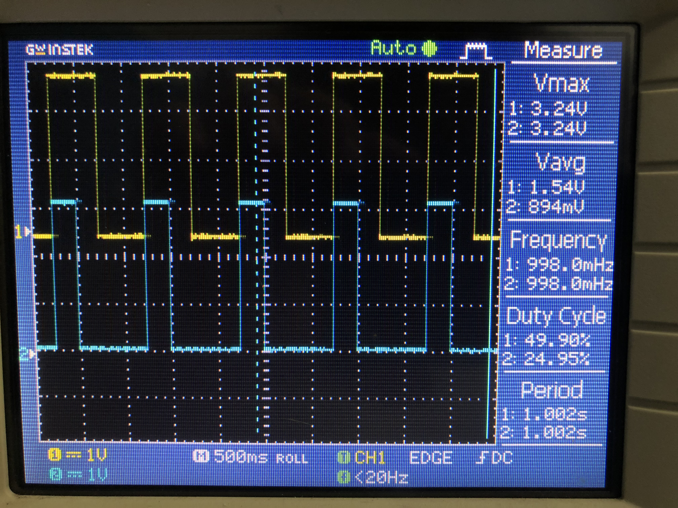
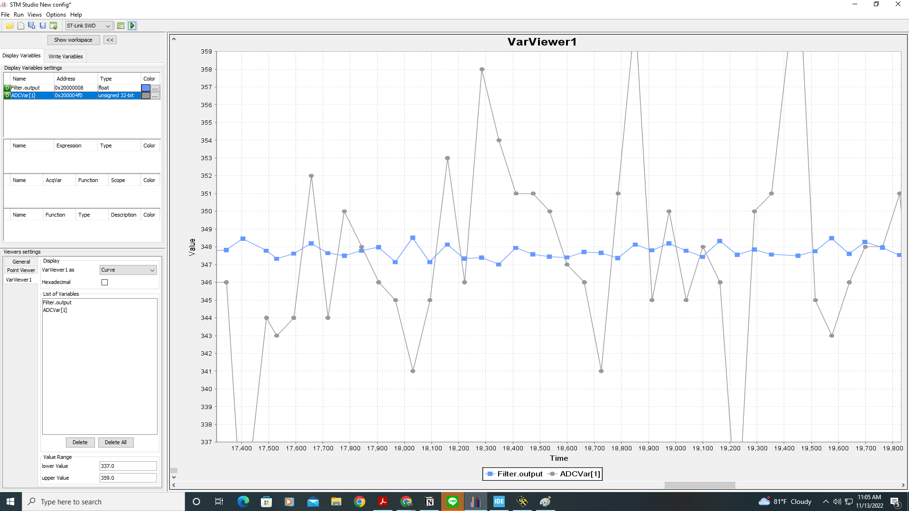
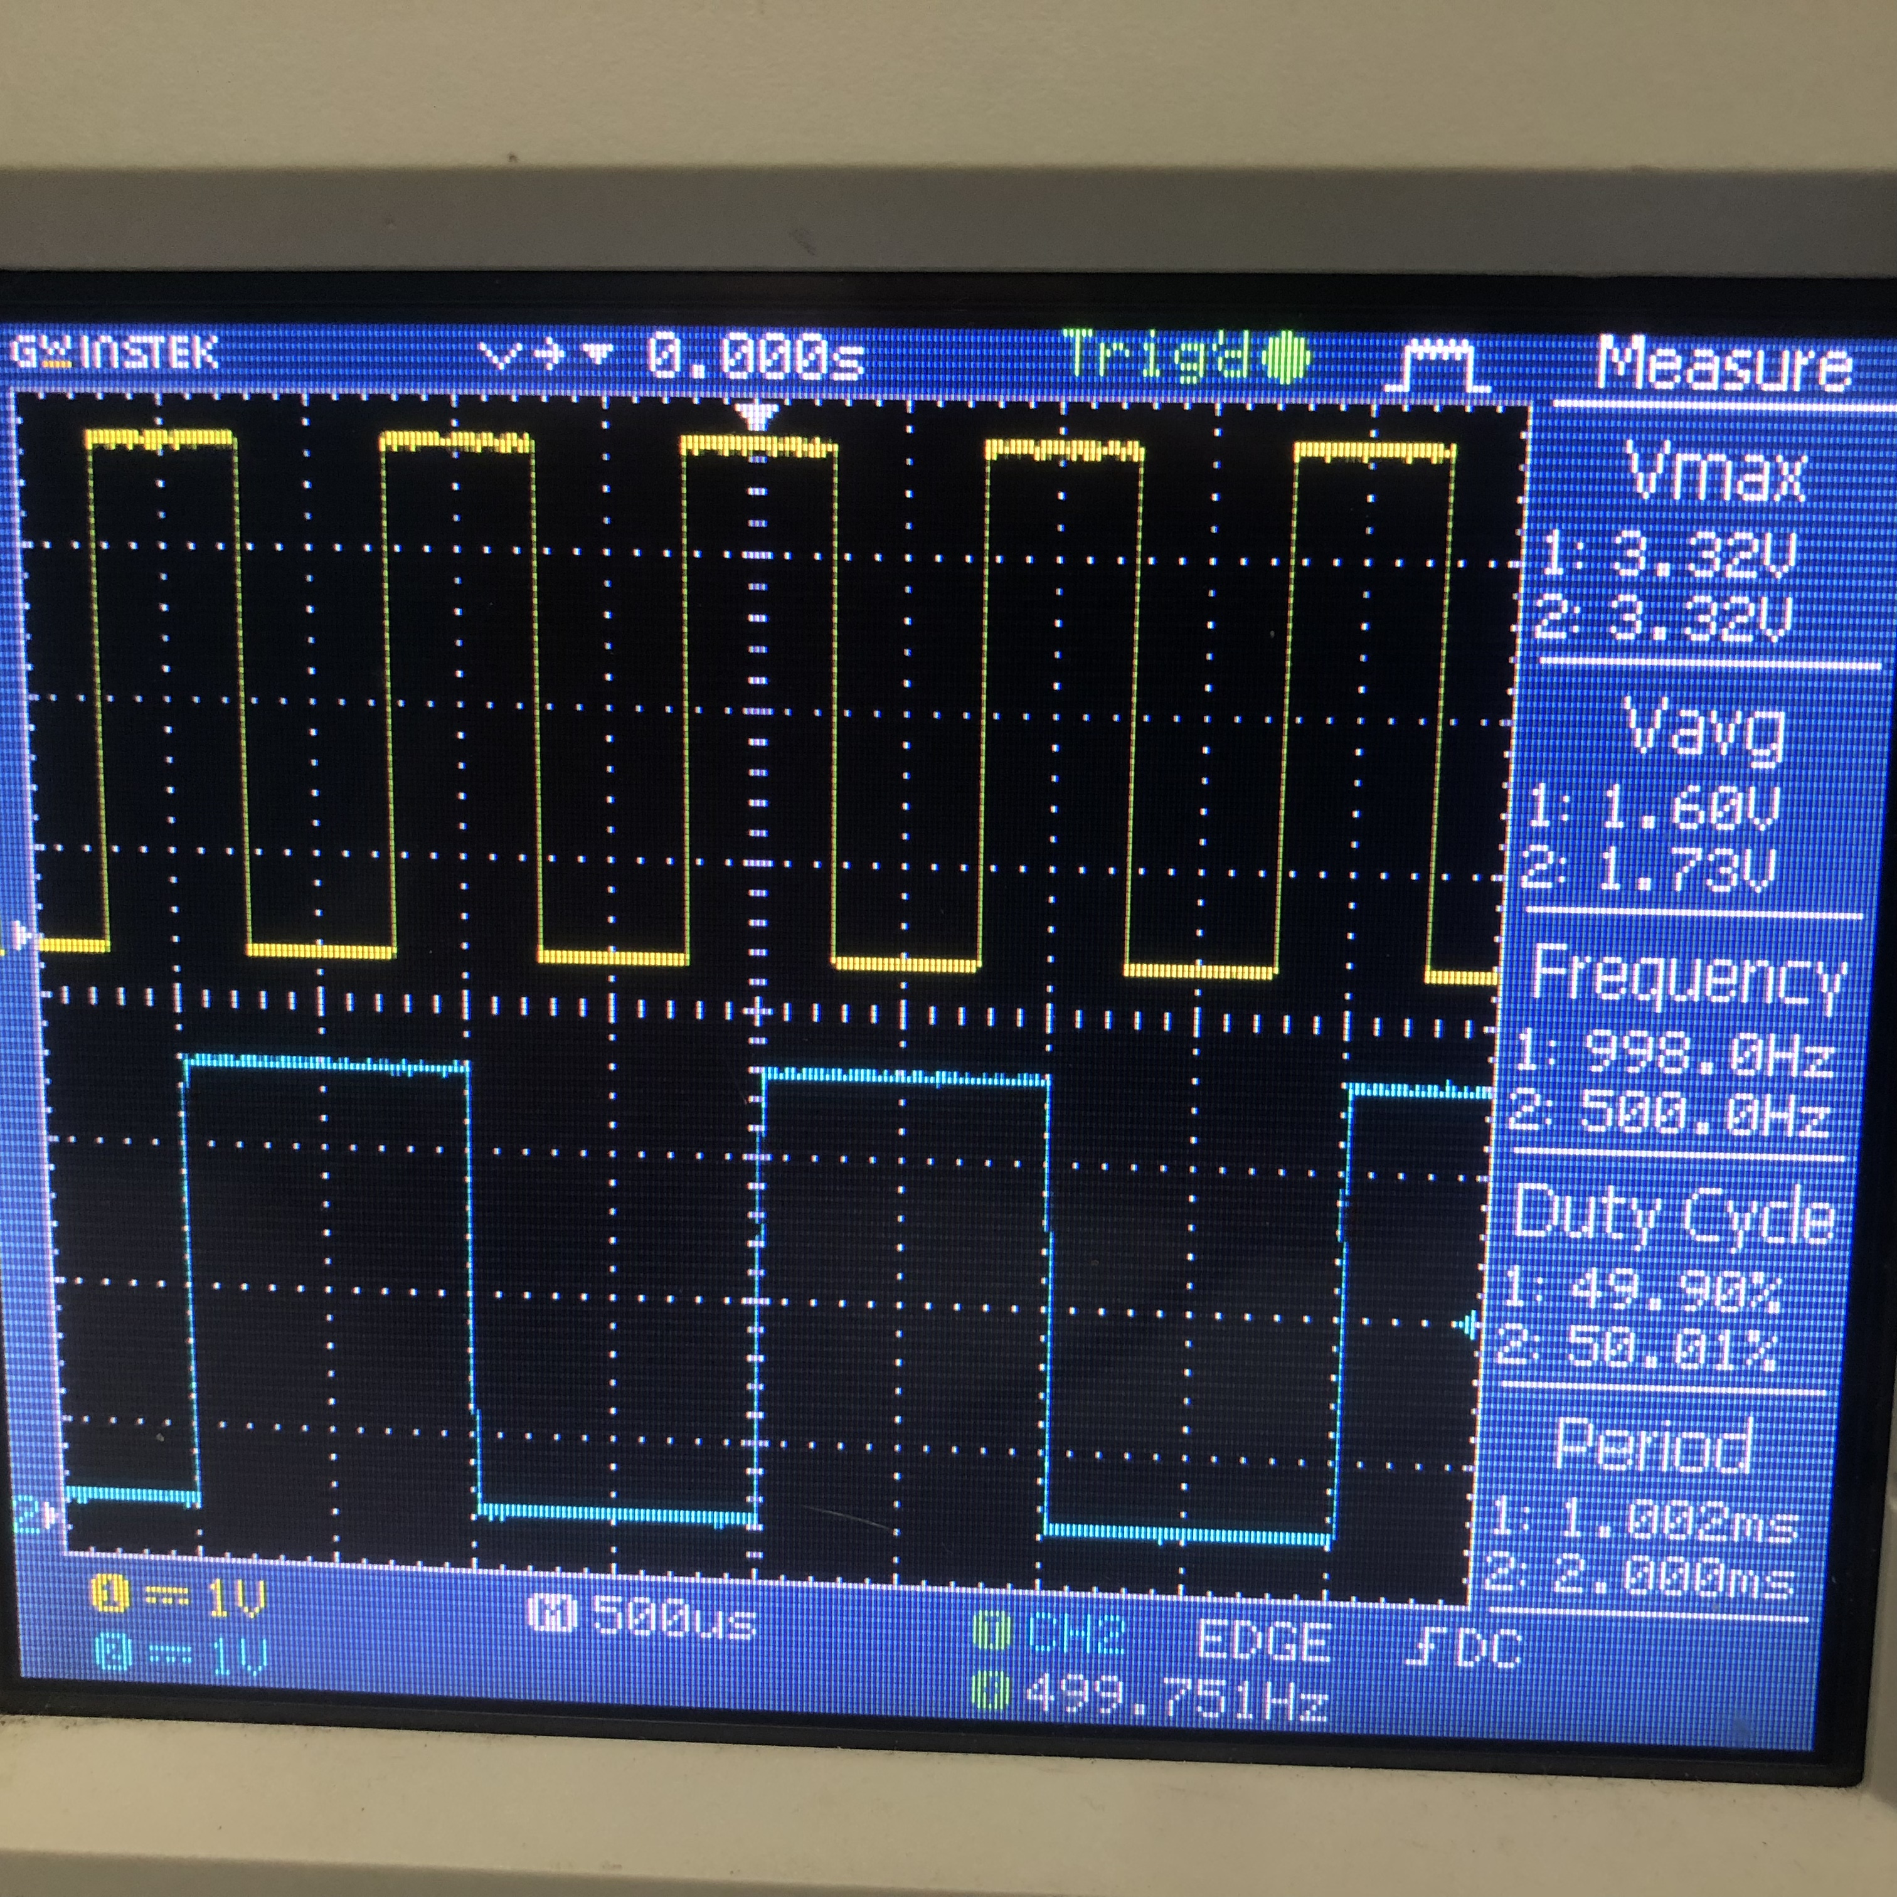
4. Result
Configuring of Timer
Configuring of ADC
ADC trigger in the middle of PWM
Notes:
https://ieeexplore.ieee.org/stamp/stamp.jsp?tp=&arnumber=8883267

Slide 13
Thank for your listening

